Slide 1
Mehrdad Pazooki
Founder of TranQuant, a data marketplace.
Founder of Toronto Apache Spark meetup group.
Email: mehrdad@tranquant.com
Slides: https://github.com/pazooki/presentations

Slide 2
Count-distinct Problem
Count-distinct problem in large datasets.

Slide 3
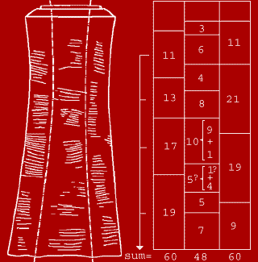
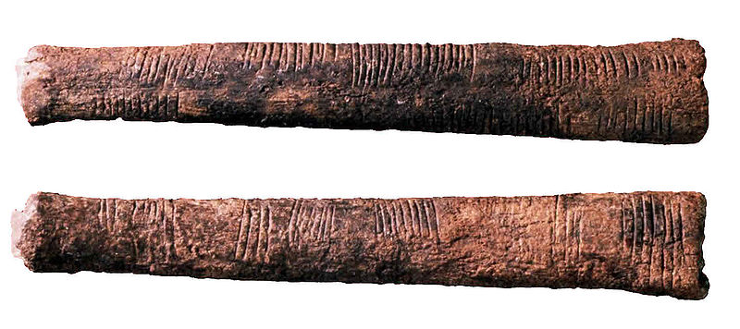
Ishango Bone (20,000 Years Old!)

Slide 4
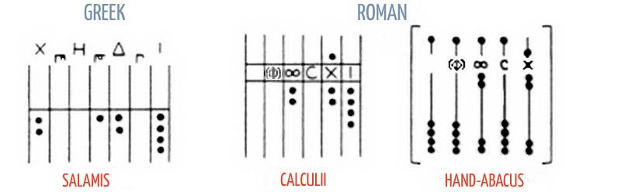
Ancient Counting Devices (500 BCE - 500 CE)

Slide 5
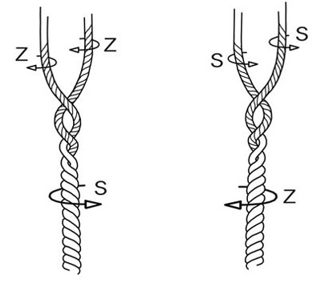
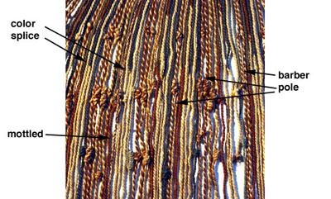
Khipu (1400)

Slide 6
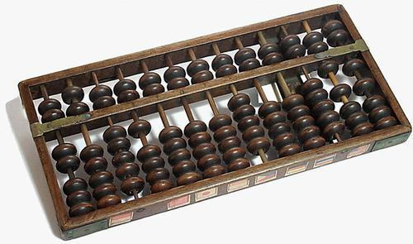
Soroban (1930)

Slide 7


Slide 8
Count-distinct problem
Finding the number of distinct elements in a dataset with repeated elements.

Slide 9
Count-distinct Problem
or
Cardinality Estimation Problem

Slide 10
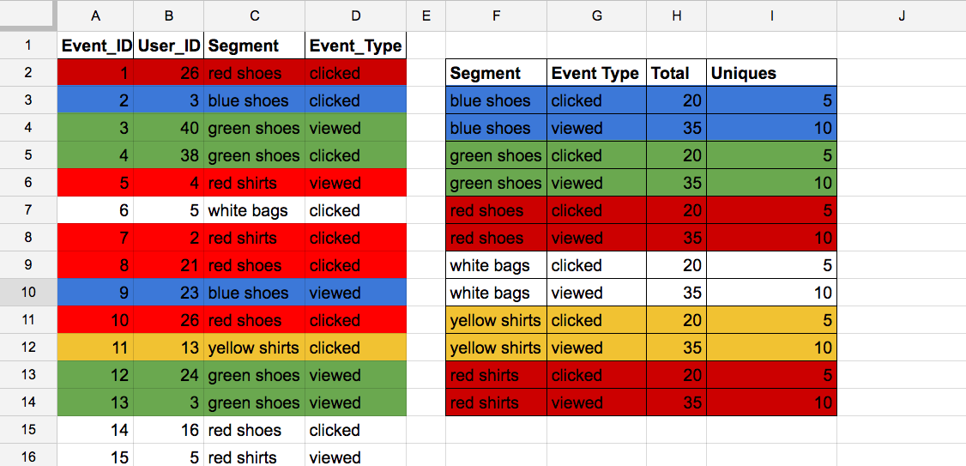
Number of unique users interested in “blue shoes”

Slide 11
Distributed Systems

Slide 12
Probabilistic Data Structures
Vs
Deterministic Data Structures

Slide 13
Deterministic Data Structures
The result of following functions:
Insert
Find
Delete
Count
...
Are always consistent.
Example: Set, Arrays,...

Slide 14
Probabilistic Data Structures
The result of following functions:
Insert
Find
Delete
Count
...
Are not always consistent.
Examples: BloomFilter, HyperLogLog, Count-min Sketch, MinHash,...

Slide 15
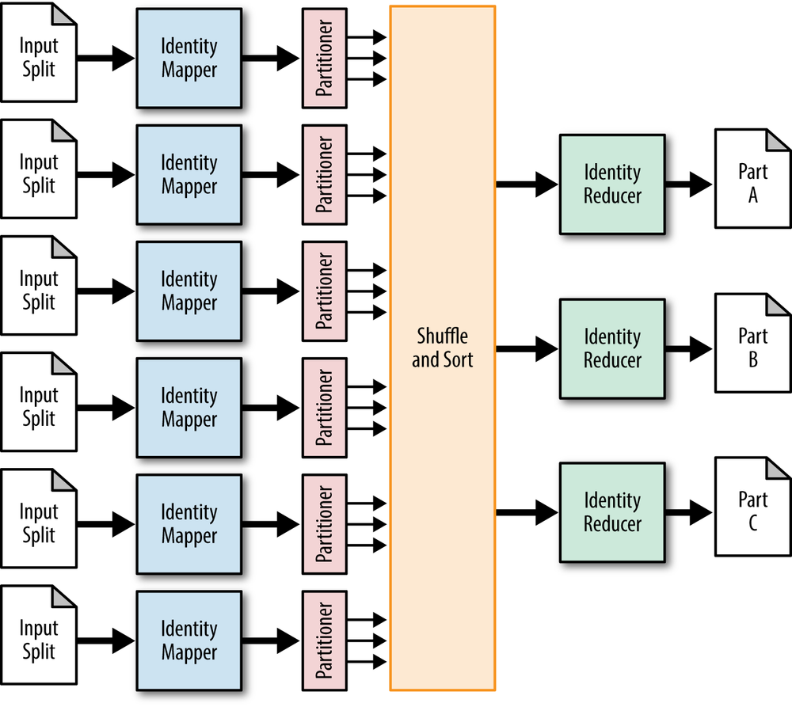
Map/Reduce

Slide 16
Number of unique users interested in “blue shoes”

Slide 17
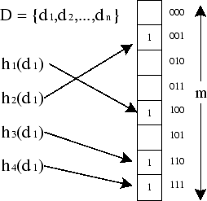
BloomFilter
A Bloom Filter that uses 4 hash functions and has a size of m=8 bits.
Notes:
A Bloom filter is a space-efficient probabilistic data structure, conceived by Burton Howard Bloom in 1970, that is used to test whether an element is a member of a set. False positive matches are possible, but false negatives are not.

Slide 18
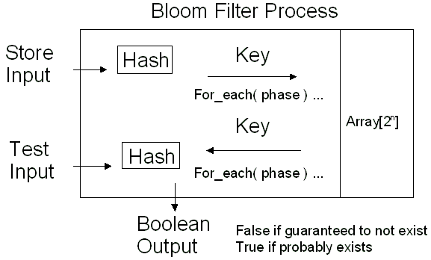

Slide 19
BloomFilter
Compact with controllable error rate
Great for fast filtering (is value V in set S?)
Fraud Detection
DDOS Attack Prevention
…
Great for problems not sensitive to false positive results
Not that great for distinct count of large datasets
It will be sparse for small datasets
Dynamic Block-Partitioned BloomFilters

Slide 20

HyperLogLog
Q: How many distinct elements are in an infinite stream of data?
Similar to
Q: How many times the coin is flipped in coin flipping?

Slide 21
Coin Flipping
Long runs of heads in random series are rare
The longer you look, the more likely you will find one
Long runs are very rare and are correlated with how many coins you’ve flipped

Slide 22
Basic HyperLogLog Algorithm
n = 0
For each input item:
Hash item into bit string
Count trailing zeros in bit string
if this count > n:
Let n = count
Estimated Cardinality (“Count Distinct”) = 2^n

Slide 23
HyperLogLog
Great for distinct count of large datasets
Fixed Memory
Some set operations:
Union
Higher error ratio
Limited spectrum for set Intersection operation
The HyperLogLog algorithm is able to estimate cardinalities of 10^9 with a typical error rate of 2%, using 1.5 kB of memory.

Slide 24
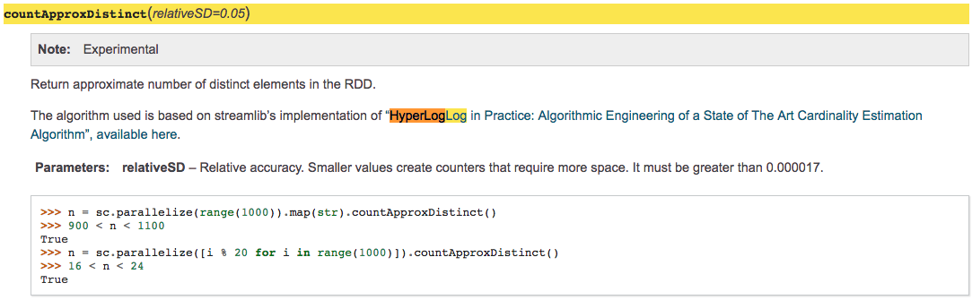
Approximate Count in Apache Spark

Slide 25
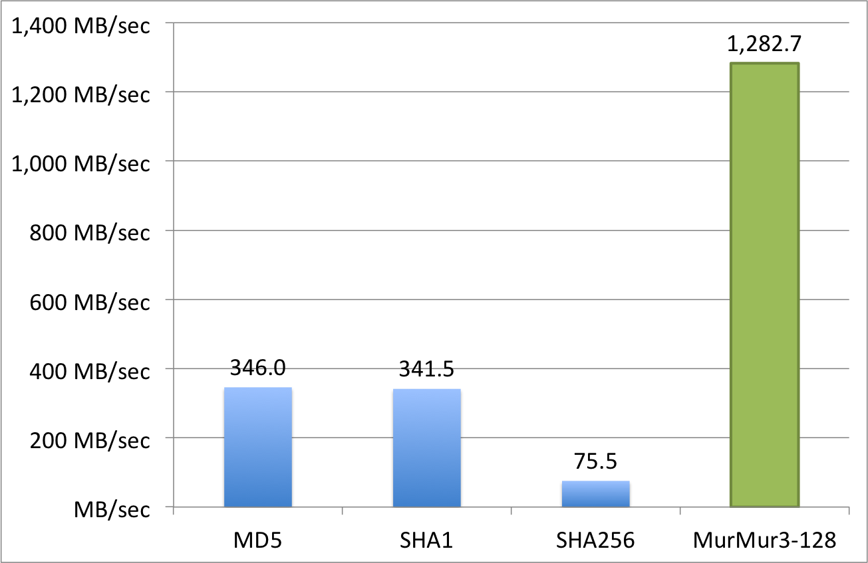
Hash Functions

Slide 26
References
https://highlyscalable.wordpress.com/2012/05/01/probabilistic-structures-web-analytics-data-mining/
https://en.wikipedia.org/wiki/Count-distinct_problem
https://en.wikipedia.org/wiki/Category:Probabilistic_data_structures
http://www.slideshare.net/a235/probabilistic-data-structures-and-approximate-solutions
http://dl.acm.org/citation.cfm?doid=2452376.2452456
http://www.ee.ryerson.ca/~elf/abacus/images/fig-antiquity.JPG
https://pdfs.semanticscholar.org/5da8/bf81712187712aed159aed62e38fb012872e.pdf

Slide 27
Thank You!
Mehrdad Pazooki
Founder of TranQuant, a data marketplace.
Founder of Toronto Apache Spark meetup group.
Email: mehrdad@tranquant.com
Slides: https://github.com/pazooki/presentations

